Slide 1
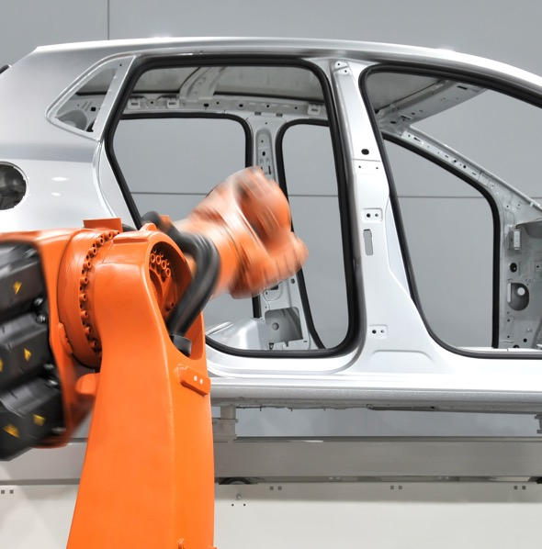



Company Overview
AXALTA 2022

Slide 2
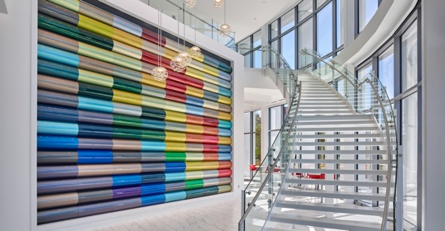
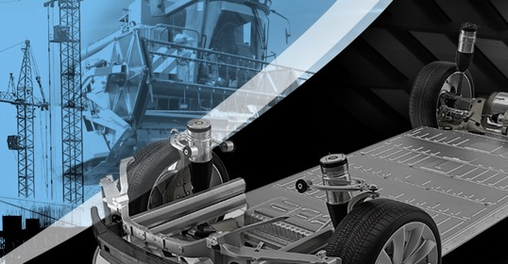

Axalta Overview
01
02
03
WHO WE ARE
BUSINESSES WE SERVE
OUR GLOBAL INITIATIVES

Slide 3
Who We Are

Slide 4
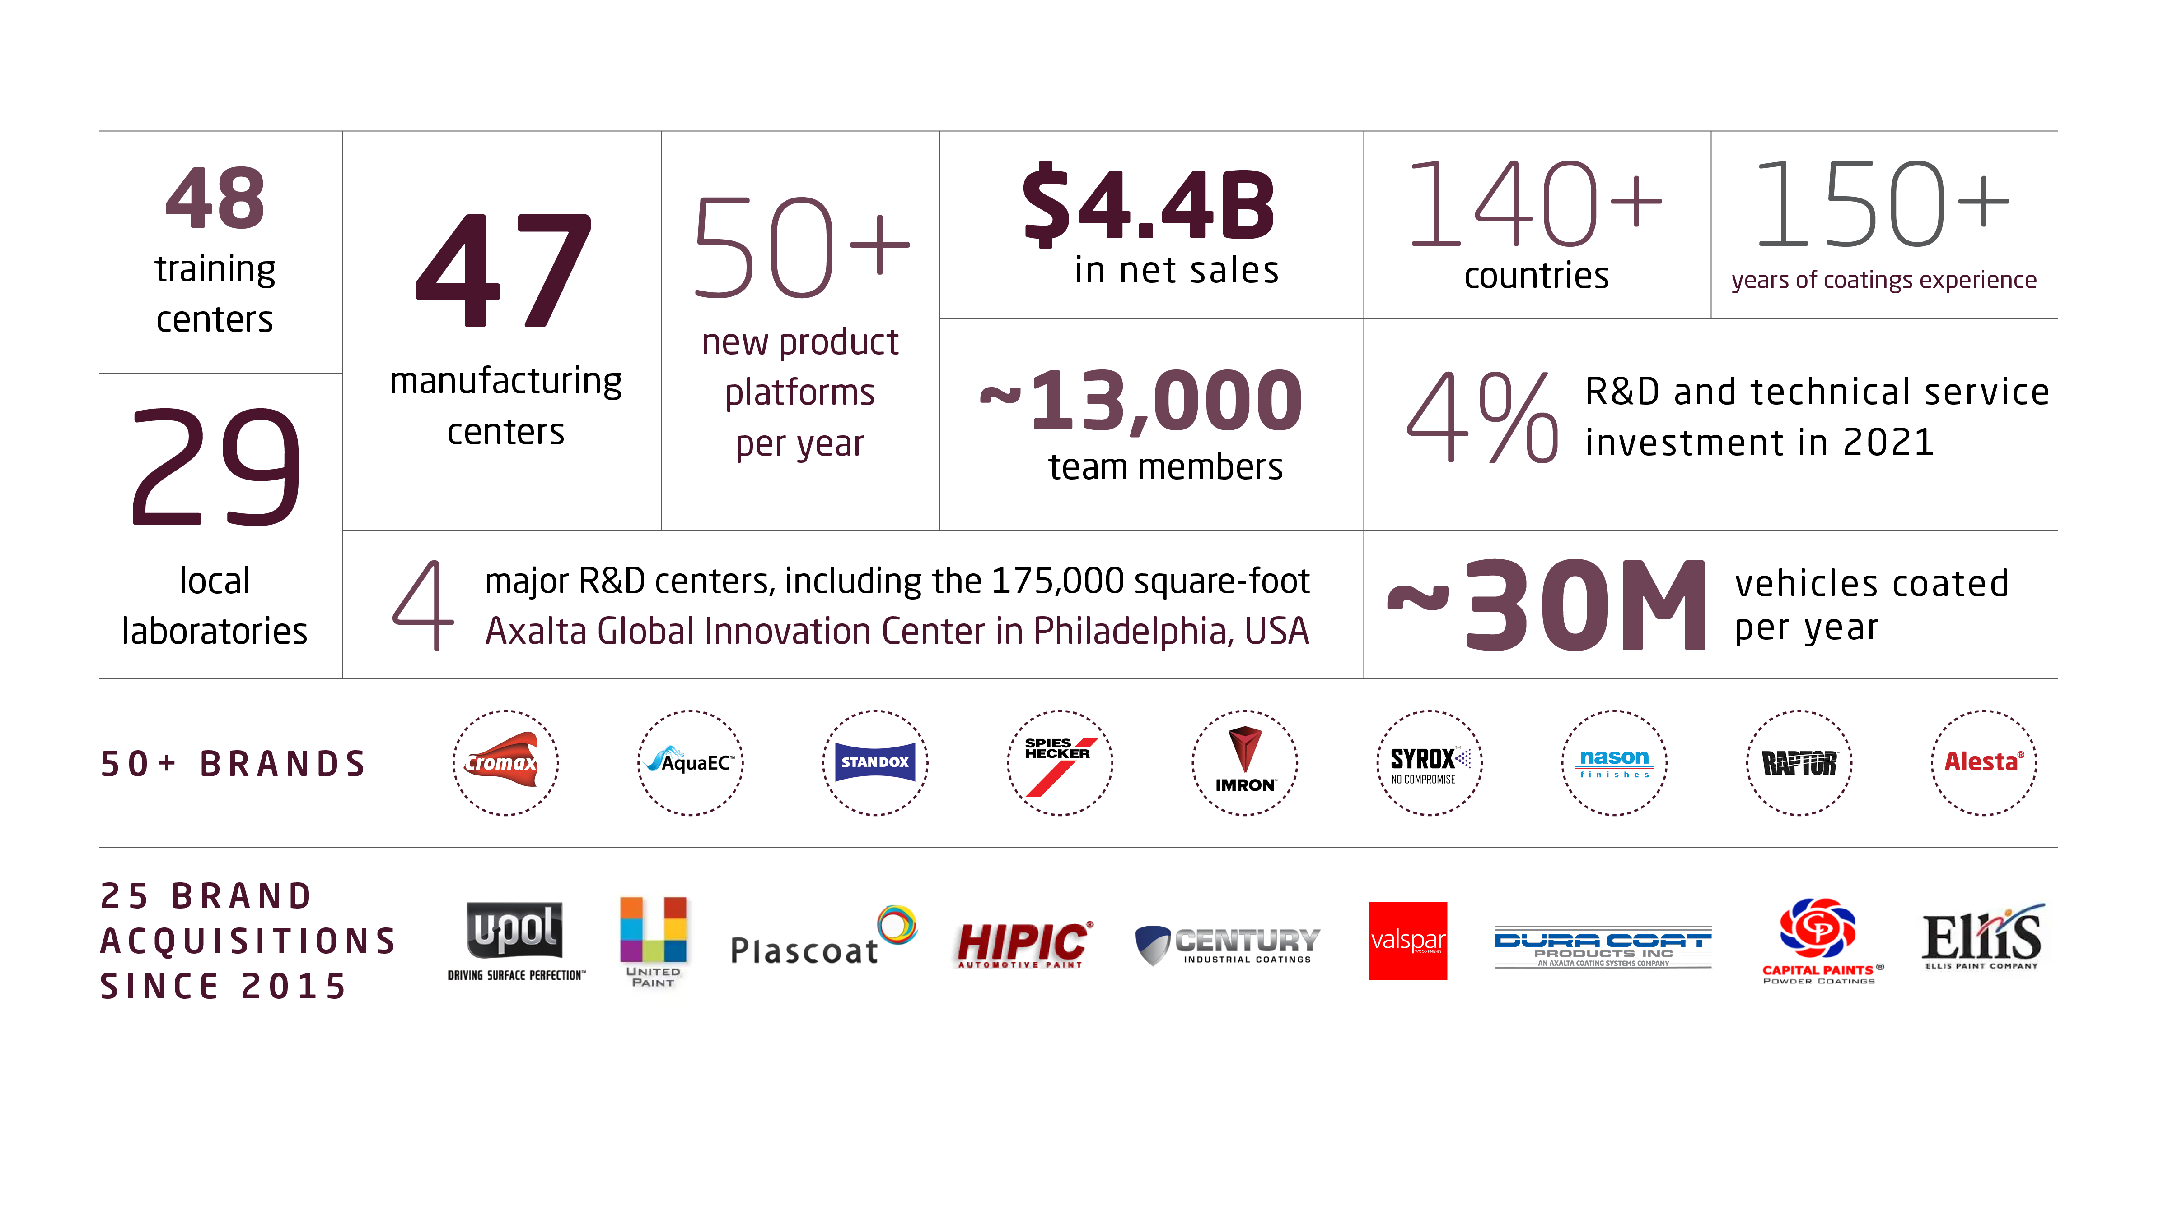
Axalta at a Glance

Slide 5
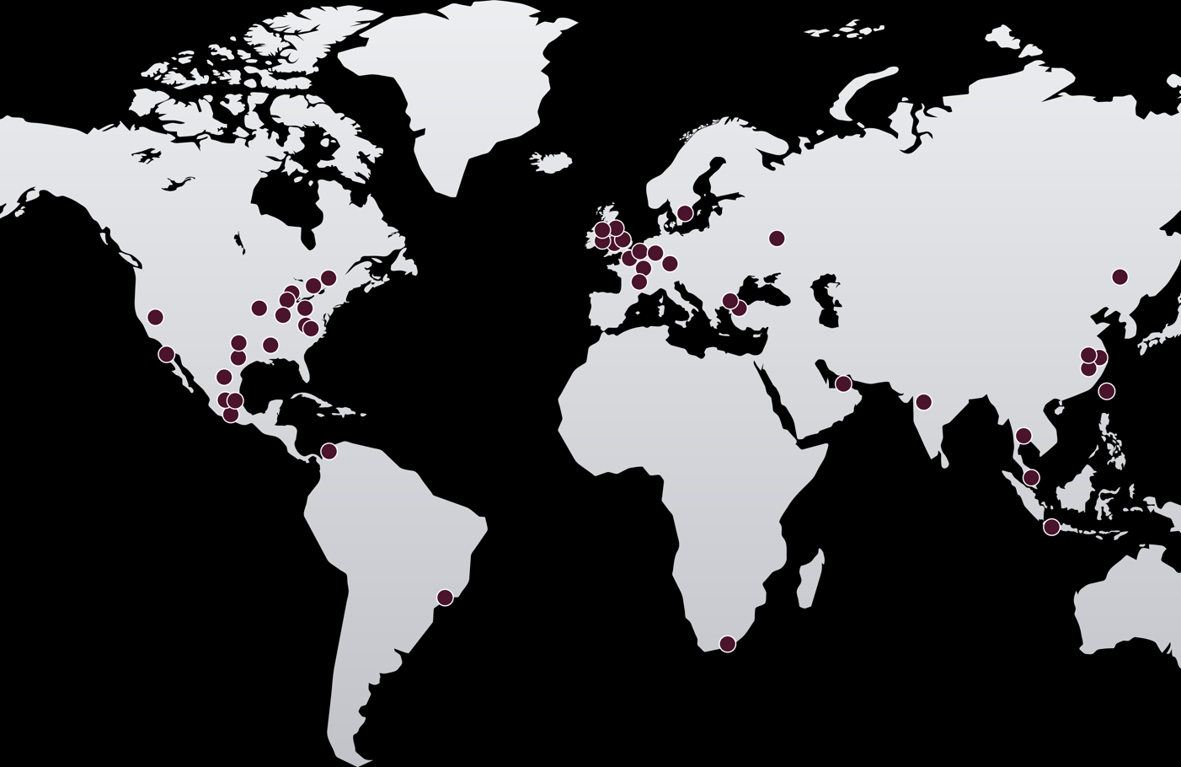
Our Global Reach
MANUFACTURING FACILITIES
NORTH AMERICA
Canada
Ajax
Cornwall
USA
Fridley, MN
Front Royal, VA
Ft. Madison, IA
High Point, NC
Hilliard, OH
Houston, TX
Jacksonville, TX
Madison, AL
Mt. Clemens, MI
Orrville, OH
Riverside, CA
Sacramento, CA
LATIN AMERICA
Brazil
Guarulhos
Guatemala
Amatitlan
Mexico
Apodaca
Ocoyoacac
Tlalnepantla
EMEA
Austria
Guntramsdorf
France
Montbrison
Germany
Landshut
Wuppertal
Netherlands
Zuidland
Sweden
Västervik
Switzerland
Bulle
Turkey
Gebze
Çerkezköy
UK
Tewkesbury
Darlington
Farnham
Huthwaite
Wellingborough
United Arab Emirates
Ras Al Khaimah
ASIA PACIFIC
China
Changchun
Jiading
Qingpu
Ma’Anshan
India
Savli
Malaysia
Shah Alam (2)
Thailand
Bangplee
JOINT VENTURE
Columbia
Cartagena de Indias
Indonesia
Cikarang
Taiwan
Taipei
JOINT VENTURE PARTNER
South Africa
Port Elizabeth
Russia
Moscow

Slide 6

World-Class Technology Infrastructure and Expertise
Wuppertal
Mount Clemens
Philadelphia
Shanghai
Global Innovation Center
Regional Technology Center
Local Laboratory

Slide 7
Businesses We Serve

Slide 8
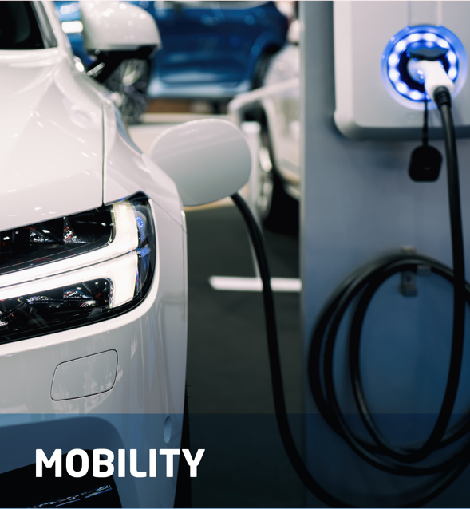
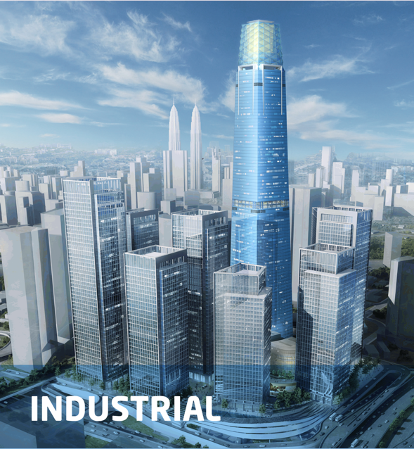
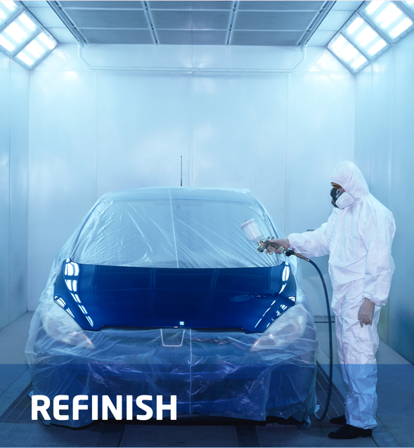
Businesses We Serve

Slide 9
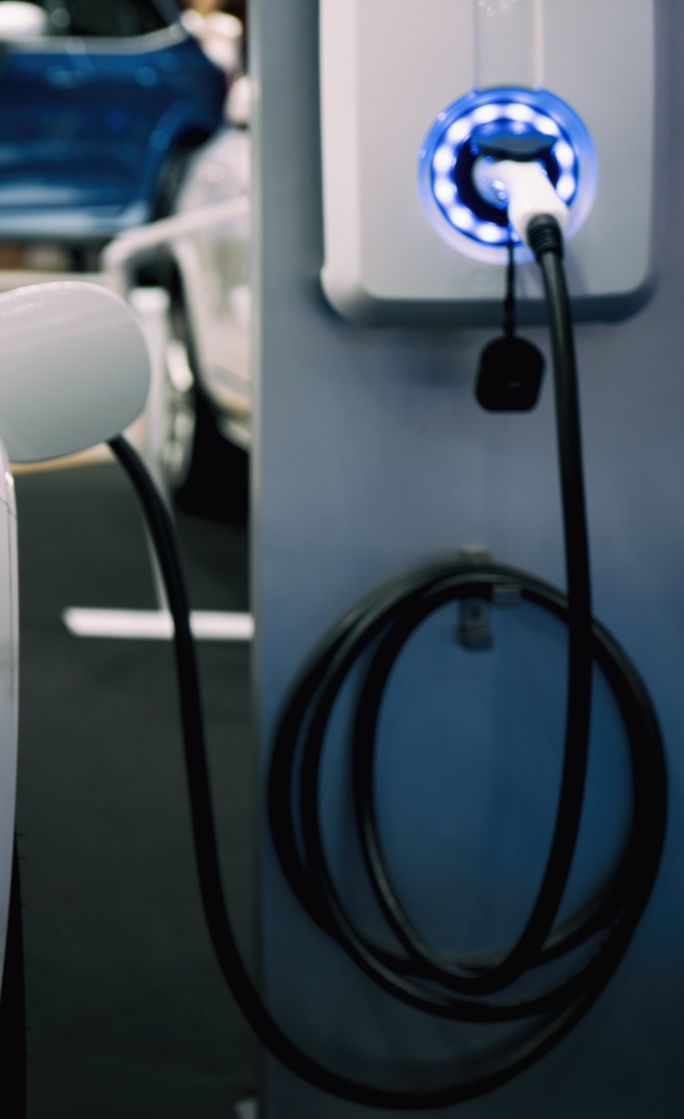
Mobility
LV BUSINESS AREAS
LV HIGHLIGHTS
#1
Automotive OEMs
Plastic and composite components
Automotive coatings application services
Broadest portfolio of harmonized coating technology
Industry leading premium clearcoats
E-coat that enables expanded list of substrates and EV platforms
in Truck and Bus
CV BUSINESS AREAS
CV HIGHLIGHTS
Heavy duty and utility trucks
Rail, bus and machinery
Recreational and off-road
Light marine and aviation
Benchmark for appearance and productivity for truck and bus market
Broadest custom color solutions
Industry leading corrosion and chip resistance
#2
in Light Vehicle
LV = Light Vehicle. CV = Commercial Vehicle
9

Slide 10
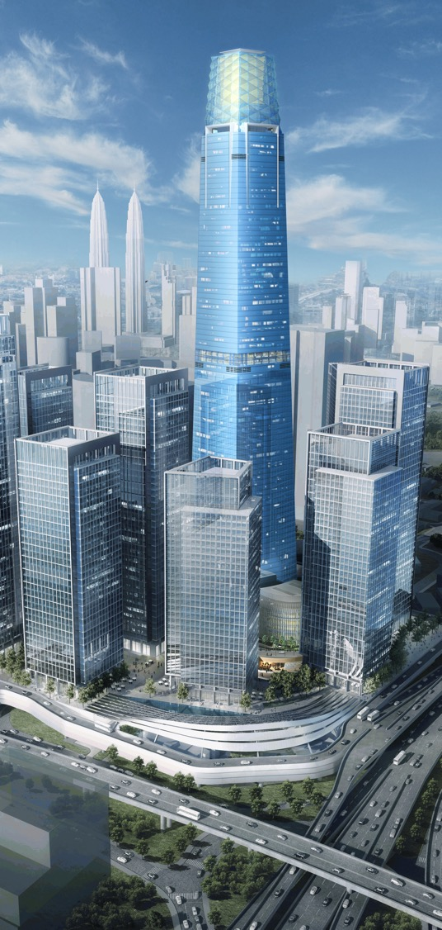
Industrial
#2
BUSINESS AREAS
Global Industrial E-Coat Supplier
General Industrial
Appliances
Architectural Extrusions
Coil Coatings
Heavy Machinery
Oil & Gas
Storage and Fencing
Structural Steel
Building Products
Building Materials
Cabinets
Wood and Luxury Vinyl Flooring
Furniture Materials
Energy Solutions
Distribution Transformers
Electric Vehicles
Energy Storage
Power Generation
Power Tools
Wind Turbines
Motor and Battery Protection
#2
North American Wood Coatings Supplier
HIGHLIGHTS
#2
Low emission electrical insulation materials for energy and e-mobility markets
Award winning primer and enamel coatings for cabinetry
Super durable extrusion products with best-in-class quality
Global Electrical Insulation Supplier
PROPRIETARY
10

Slide 11


Refinish
BUSINESS AREAS
HIGHLIGHTS
#1
Independent body shops
Multi-shop operators (MSOs)
Auto dealership groups
Industry leading color capability
Most productive waterborne basecoat technology
Develop tailored technology for Premium, Mainstream and Economy segments
Market Position

Slide 12
Our Global Initiatives

Slide 13



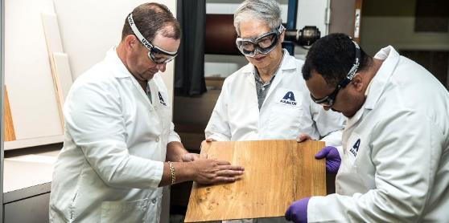
Innovation at Axalta
DEEP EXPERTISE IN COATINGS ENABLES CUTTING EDGE PRODUCT INNOVATIONS FOR OUR CUSTOMERS
Focus on color technology, polymer & formulation chemistry and coatings application
Global technology community of ~1,300 scientists, engineers and technicians with diverse skills/disciplines
Focused teams for product development, process enhancements and technical support
>500/yr
~20K/yr
>20K/yr
Product Modifications
Service Requests
Color Developments
PROPRIETARY
13

Slide 14

Innovation: Strategic Approach
FOCUS ON CUSTOMER NEEDS
INVEST FOR GROWTH
INNOVATION ADVANTAGE
Deep understanding of market and customer needs
Focused projects to address existing and future needs
Market leading investment
Leading products and technologies
Accelerated organic growth
Sustainable solutions
Preferred supplier / partner
Color Aesthetics
Unique style and flair
Visually interesting
Expanded color palette
Productivity
Cycle time improvement
Faster drying
Mass customization
Sustainability
Reduced emissions
Lower usage
Reduced energy
Performance
Durability
Multi substrate
Electric motor insulation
2021 Technology Investment
4% R&D and technical services investment in 2021
Investment across all business segments
50 new product platforms introduced per year that drive the majority of organic growth
Focused customer solutions that drive growth and defend key business
Innovation: Beyond Products
Processes: Changing approach to increase efficiency
Services: Unique ways to meet diverse customer needs
Digitalization: Exploring new digital tools to improve efficiency
Innovation is our differentiator and a true competitive advantage
PROPRIETARY
14

Slide 15























Sustainability at Axalta: Our 2030 Goals
ENVIRONMENTAL
GOVERNANCE
50%
>20%
10%
80%
100%
absolute reduction of Scope 1 and 2 GHG emissions, sourcing at least 50% of electricity from renewable sources
Carbon neutral by 2040
increase in the percentage of net sales from products, services, and tools that offer sustainability benefits to our customers/ markets/communities
reduction of process waste, VOC emissions, and water use from operations (normalized to production)
of new technology and innovation developments will have a sustainability benefit
active global employees trained on Code of Business Conduct and Ethics
SOCIAL
100%
30%
$5M
of key suppliers assessed against a robust set of sustainability criteria, reflecting environmental, governance, and reputational risks, including human rights
of management positions to be filled by women
30% of management positions to be filled by under-represented racial /ethnic groups (in US & Canada)
Establish, track, and improve upon a favorable Inclusion Index
donated to our communities through Axalta’s Bright Futures Program
Global top decile recordable injury rates annually while continually striving towards zero injuries
Conduct employee engagement survey annually, and achieve participation rates and employee confidence in company follow-up actions greater than the provider benchmark

Slide 16
Thank You

